Slide 1
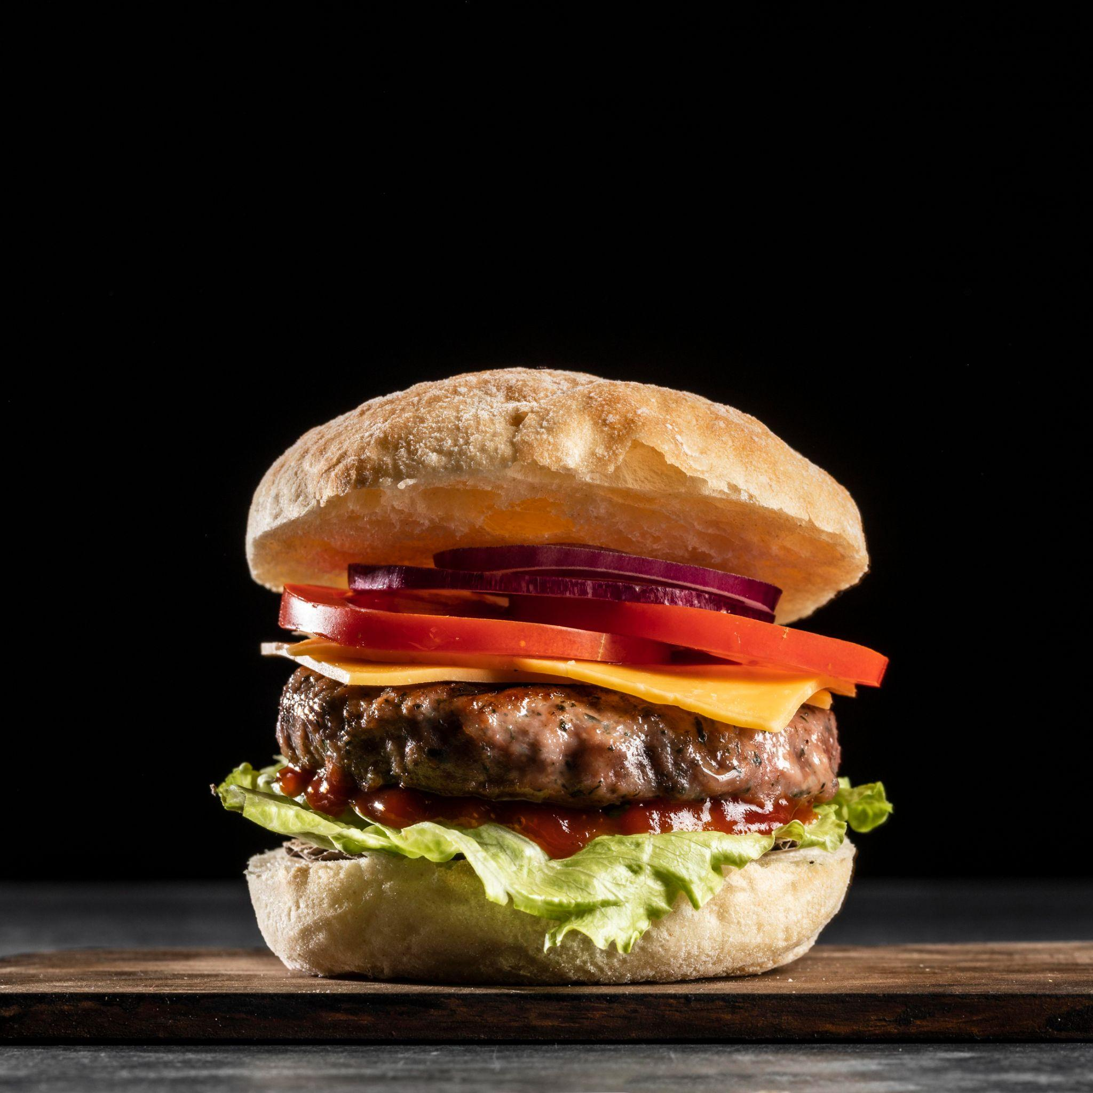
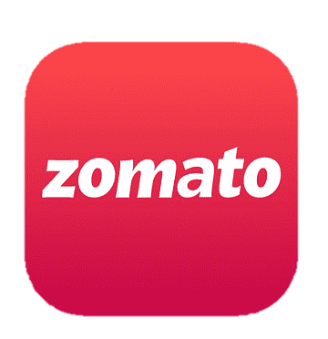
Zomato Analytics
- Group 2
Shubhangi Vishnu Gosake
Chavan Aditya Anil
Vikash kumar
Neelam Venkata Sai Varun
Vinishia Boniface
Satyajeet Palai
Radhika Chatwani
Samruddhi Jadhav

Slide 2

Table of Contents
01
02
03
Project Overview
Challenges and
Solutions
Introduction
04
05
06
07
KPIs
Dashboards
Inference
Conclusion

Slide 3


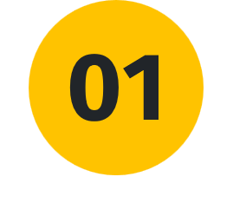
Introduction
This project explores the restaurant industry using a comprehensive dataset analyzed with Excel and SQL for data preparation and visualized through Power BI and Tableau. The focus is on uncovering trends in restaurant distribution, ratings, pricing, and service features, with actionable insights for Zomato to strengthen its role in the food ecosystem.

Slide 4
Project Overview
02
The analysis encompasses:
Key Performance Indicators (KPIs):
Exploring critical metrics like restaurant distribution, ratings, pricing trends, and service features.
Performance Evaluation:
Assessing Zomato’s position in the competitive landscape and areas of strength.
Gap Analysis and Solutions:
Identifying gaps in services like table booking, premium offerings, and digital adoption.
Proposing strategic solutions to address these gaps and drive future growth.
Objective: To derive actionable insights that enable Zomato to optimize its performance, modernize its services, and expand its market presence.

Slide 5
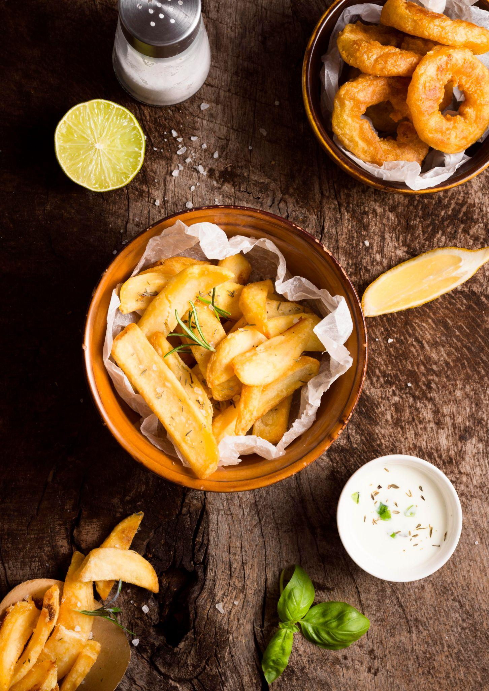
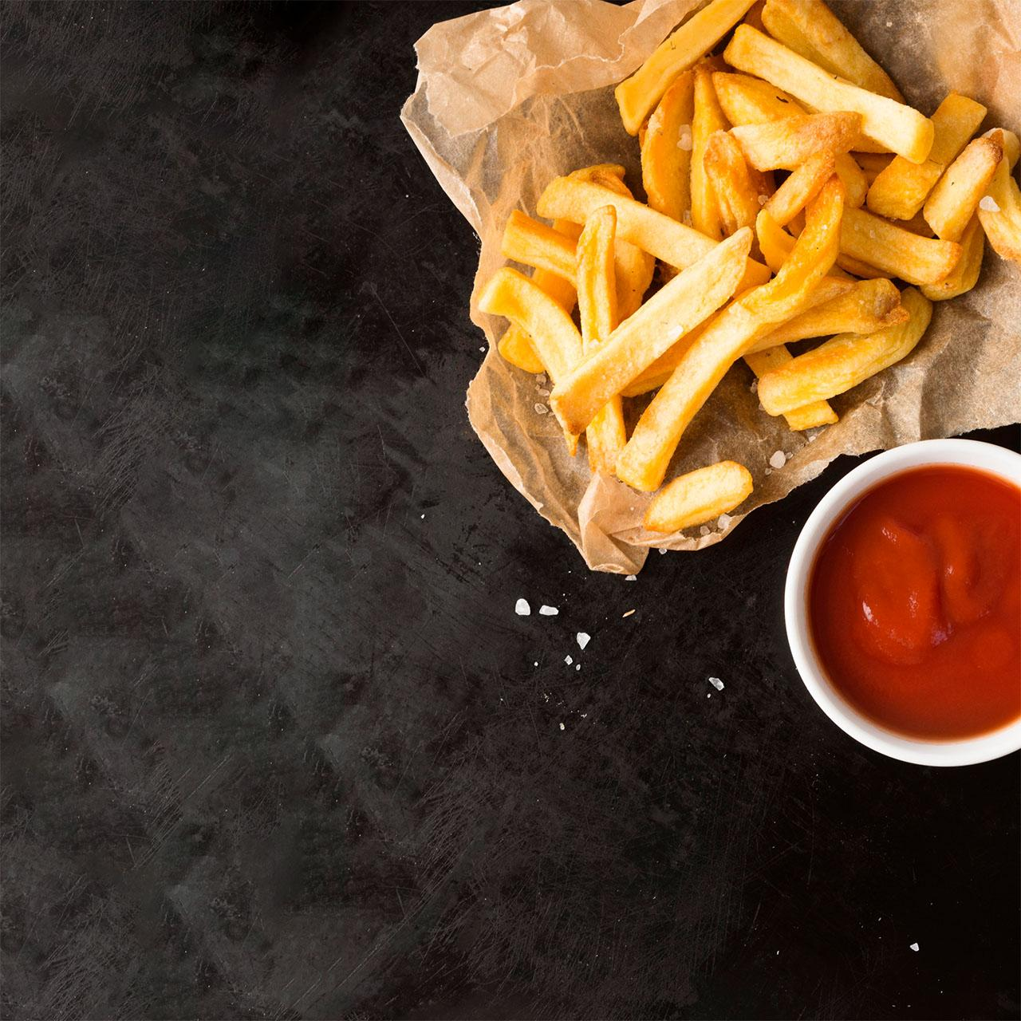


Challenges and Solutions
03
1. Excel – Calendar Table Creation
Challenge: Difficulty in creating a calendar table with financial quarters and months.
Solution: Used the Data Model shortcut to create a calendar table with one click, deriving quarters and months using DAX.
2. MySQL – Importing File
Challenge: Only 803 rows out of 9k+ rows uploaded via the Table Import Wizard.
Solution: Resolved the issue by using the LOAD DATA INFILE command with a properly formatted file path.
3. Power BI and Tableau
Challenge: None. These tools worked seamlessly.
4. Time Management & Organization:
Set deadlines to ensure timely completion of tasks.
Divided tasks among group members based on individual strengths.
Scheduled regular group meetings for feedback, corrections, and effective team coordination.
Takeaway: Effective problem-solving, team collaboration, and time management played a key role in overcoming challenges and ensuring smooth execution.

Slide 6
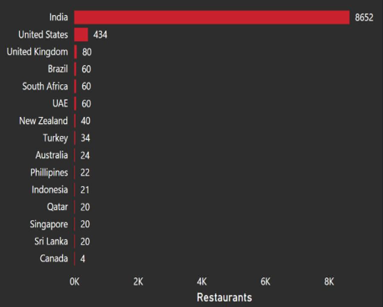
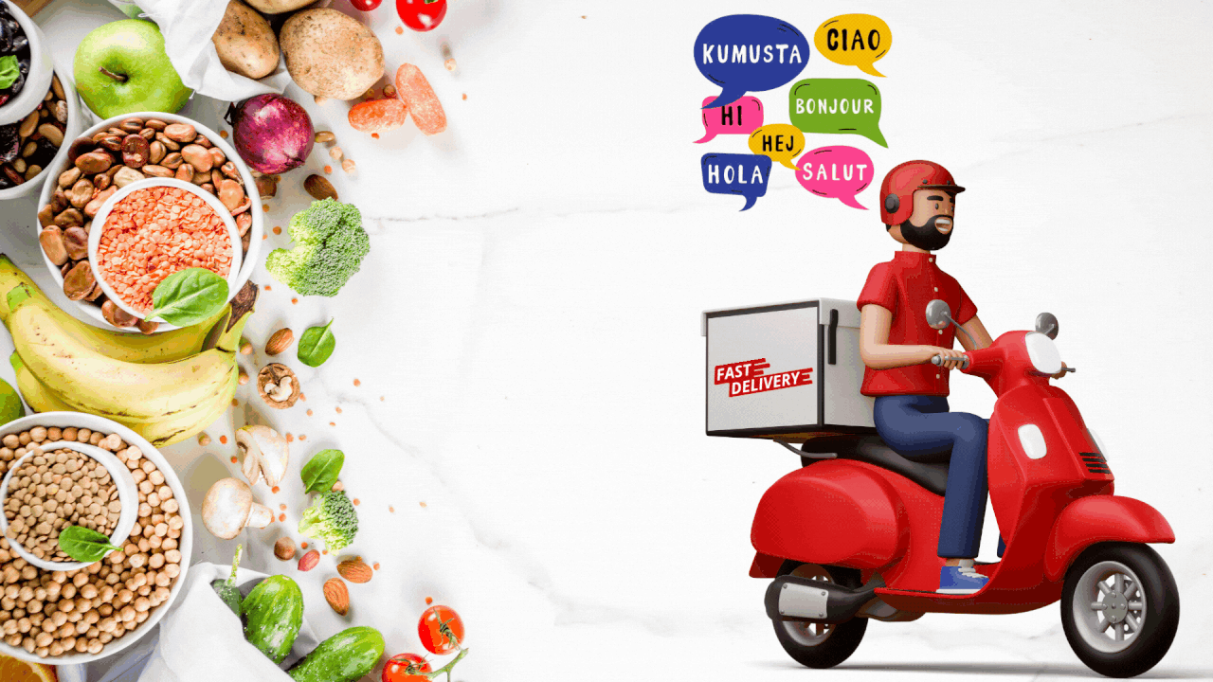
KPI-1
04
KPI 1 : Country Wise Restaurants Distribution
Overall Distribution:
The chart illustrates the number of restaurants in various countries. India stands out with a significantly higher number of restaurants, reaching 8652. Other countries have considerably fewer restaurants, with most falling below 100.
Key Observations :
India Dominance: India has a substantial lead in terms of restaurant count i.e. 8652, highlighting its thriving food scene.
Low Restaurant Count: Most countries have a relatively low number of restaurants, suggesting that the food industry in these regions may not be as developed or as widely accessible.
US Presence: While the US has a higher restaurant count compared to other countries, it's still significantly lower than India’s.

Slide 7

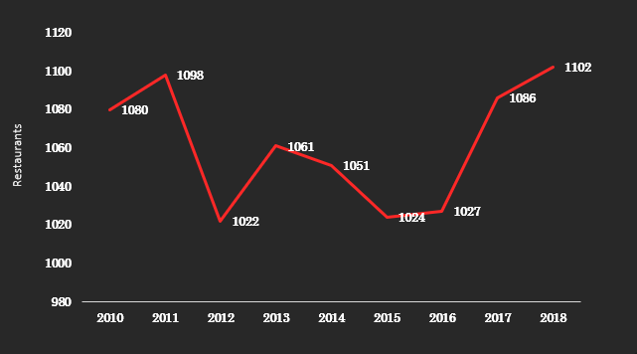
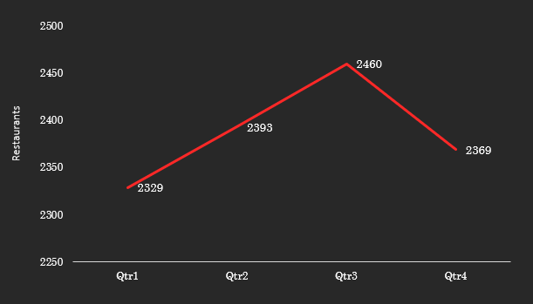
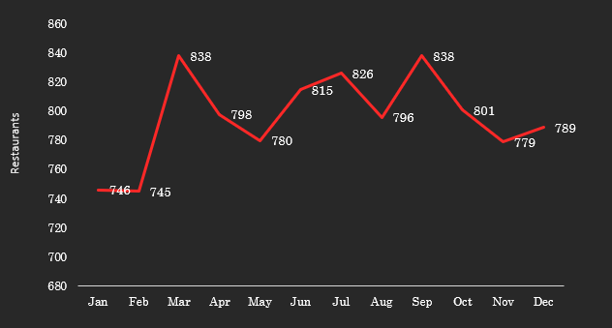
KPI-2
04
KPI 2 : Trends in Zomato Restaurants: Annual, Quarterly, and Monthly Insights
Chart 1: Yearly Trend (2010–2018):
From 2010 to 2012, there was a dip, with a low point in 2013 at 1022 restaurants.
A recovery began in 2014, followed by a consistent increase from 2016 to 2018, peaking at 1102 restaurants in 2018.
Chart 2: Quarterly Trend:
The number of restaurants grows significantly in Q3, reaching 2460, the peak of the year.
Q4 shows a sharp decline, dropping to 2369, which may indicate a seasonal factor or a business cycle impact.
Chart 3: Monthly Trend:
January starts at 746 restaurants, followed by a slight drop in February.
Peaks occur in March, June, and September at 838 restaurants.
The numbers fluctuate across the year, with a notable dip in November (779 restaurants), before slightly recovering by December (789 restaurants).

Slide 8
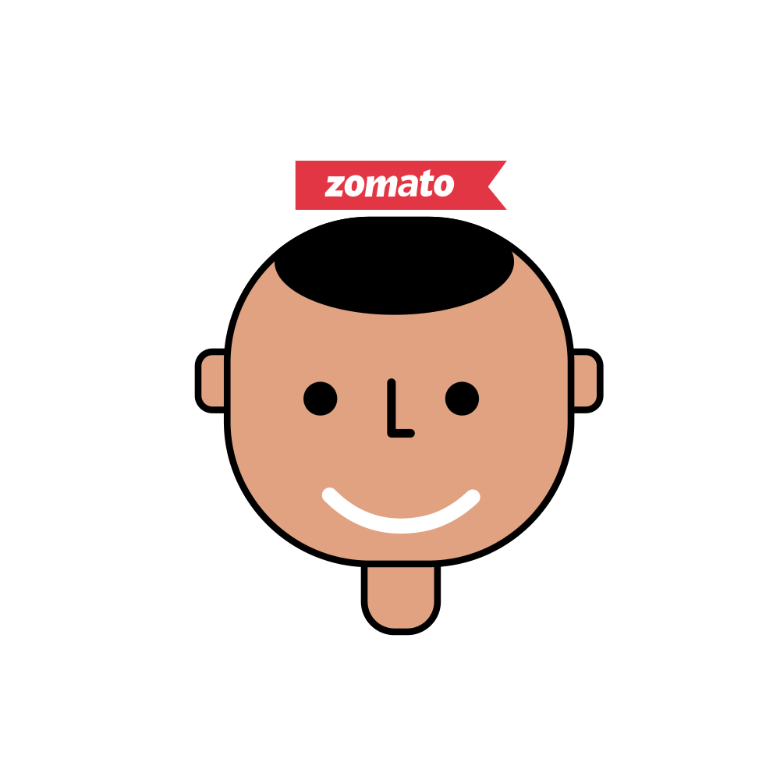
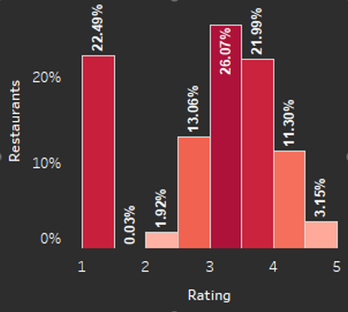
KPI-3
04
KPI 3 : Count of Restaurants based on Average Ratings
Rating 1: 22.49% (High proportion of poorly-rated restaurants).
Rating 2: 1.92% (Few with slightly better ratings than 1).
Rating 3: 26.07% (Majority rated as average).
Rating 4: 21.99% (Decent share with above-average ratings).
Rating 5: 3.15% (Very few rated as exceptional).
Key Insight:
Ratings are concentrated at 1 and 3, with limited high-quality establishments (4 & 5), highlighting opportunities for improvement.

Slide 9

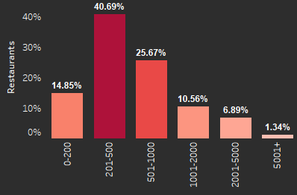
KPI-4
04
KPI 4 : Restaurant Distribution Across Price-Buckets
₹0–200: 14.85% (Small share of low-priced options).
₹201–500: 40.69% (Largest proportion, indicating this price range dominates).
₹501–1000: 25.67% (Second largest, moderately priced options).
₹1001–2000: 10.56% (Limited share in higher price range).
₹2001–5000: 6.89% (Niche, premium pricing).
₹5001+: 1.34% (Rare ultra-premium restaurants).
Key Insight: Restaurants predominantly fall in the ₹201–500 range, catering to budget-conscious customers, with limited representation in premium price brackets.

Slide 10
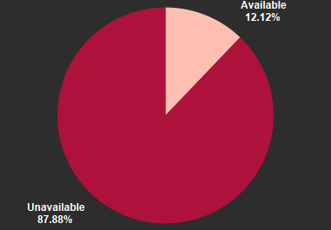
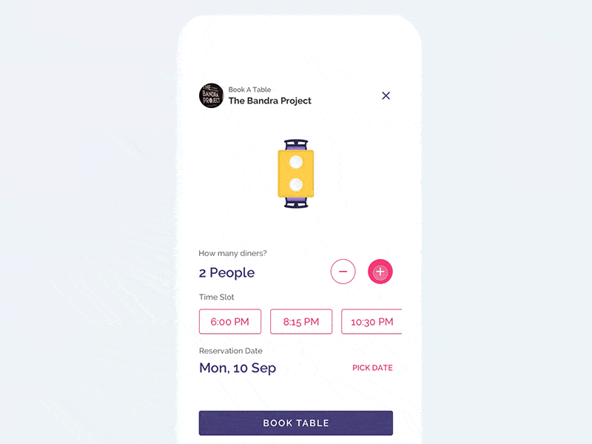
KPI-5
04
KPI 5 : Restaurants based on Table booking
Overall Distribution :
The chart shows the distribution of restaurants based on whether they offer table booking. It appears that a significant majority of restaurants (87%) do not offer table booking, while only 12% do.
Key Observations :
Dominance of Unavailable Table Booking: The large slice of the pie indicates that most restaurants do not have a formal table booking system.
Minority with Table Booking: Only a small percentage of restaurants offer table booking, suggesting that this feature is not widely adopted.

Slide 11
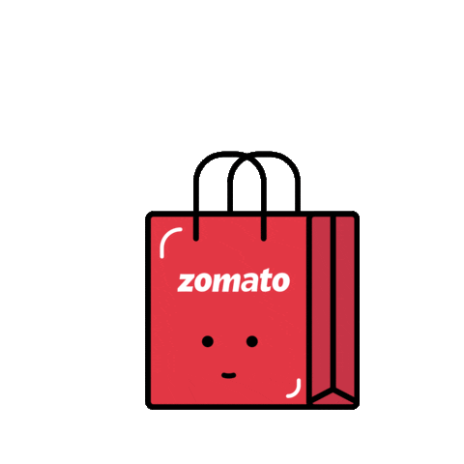
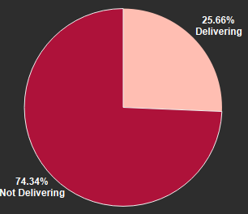
KPI-6
04
KPI 6 : Restaurants based on Online delivery
Overall Distribution :
The chart shows the distribution of restaurants based on whether they offer online delivery. It appears that a significant majority of restaurants (74%) do not offer online delivery, while only 26% do.
Key Observations :
The fact that 74% of restaurants don't offer delivery is a massive opportunity for Zomato, as it can position itself as the key enabler of this service. By focusing on onboarding these restaurants, Zomato stands to grow its restaurant network and revenue while capturing a larger share of the food delivery ecosystem.

Slide 12

Inference
06
Global Restaurant Landscape
Country-Wise Distribution:
India leads with 8652 restaurants, showcasing its thriving food culture.
Most other countries have fewer than 100 restaurants, indicating potential for market expansion.
The US has a notable presence but is still far behind India.
2. Industry Growth (2010–2018):
Steady growth in new restaurant openings, reflecting increasing demand.
Year-to-year fluctuations, but the overall trend is upward.
Takeaway: India dominates the global scene, and the industry is steadily expanding, signaling growing opportunities.

Slide 13
Inference
06
Restaurant Ratings & Price Accessibility
1. Ratings Distribution
High concentration in Rating 1 (22.49%) and Rating 3 (26.07%).
Limited high-quality establishments (4 & 5 ratings account for only 25%).
Opportunity to improve customer experiences and service quality.
2. Price Buckets
₹201–500: 40.69% of restaurants dominate this range (budget-focused).
Premium categories (₹1001–5000+): Only 8.23%, indicating untapped potential for higher-end services.
Takeaway: Restaurants lean toward affordability but lack premium options and consistent quality.

Slide 14
Inference
06
Service Features
1. Table Booking
87% of restaurants lack table booking, showcasing low adoption of structured dining systems.
Only 12% of restaurants support table bookings, presenting a modernization opportunity.
2. Online Delivery
74% of restaurants do not handle delivery independently, creating a massive opportunity for Zomato as an enabler.
By onboarding these restaurants, Zomato can:
Expand its network and customer options.
Enhance restaurant visibility and revenue.
Take Away:
Zomato is uniquely positioned to drive digital transformation, making delivery and booking more accessible for restaurants.

Slide 15
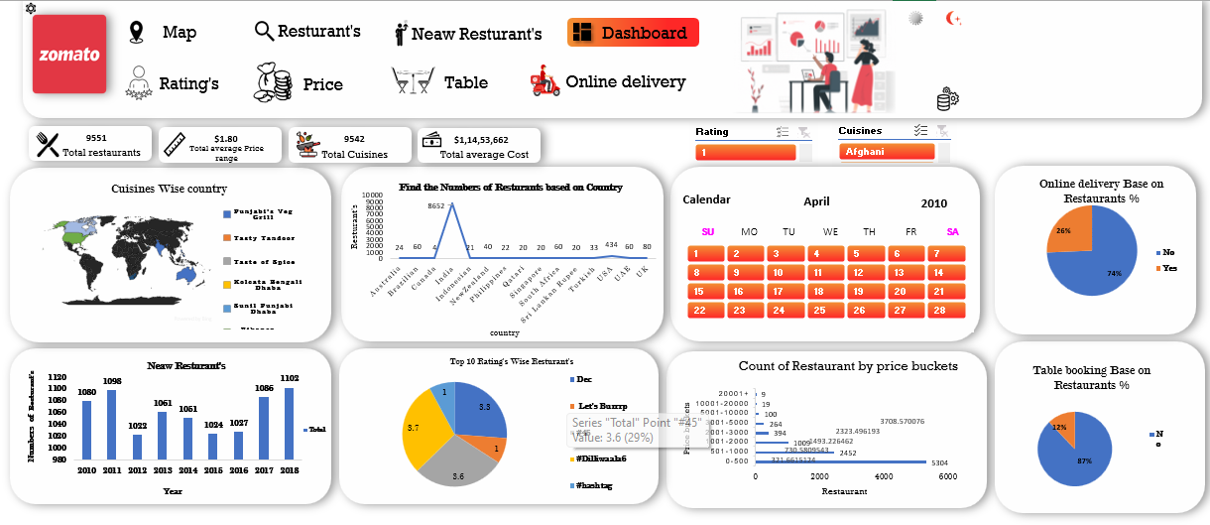
Excel Dashboard
05

Slide 16
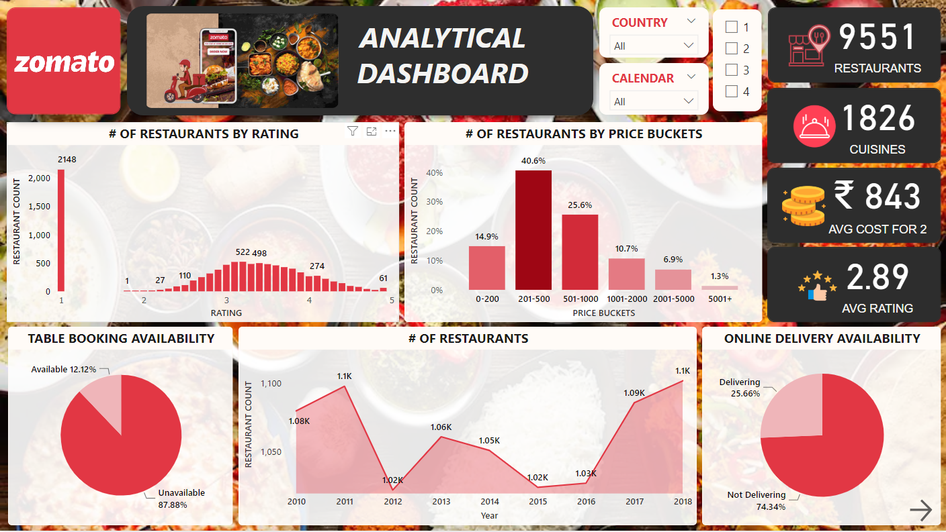
PowerBI Dashboard
05

Slide 17
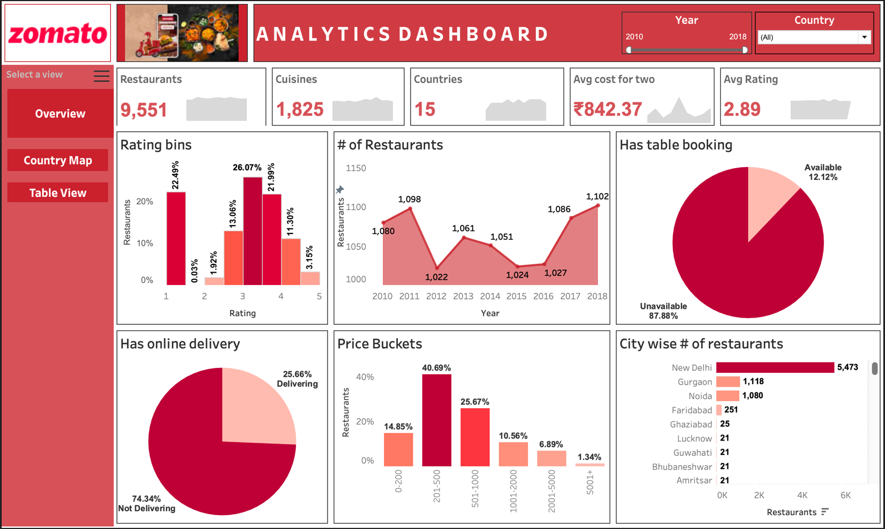
Tableau Dashboard
05

Slide 18
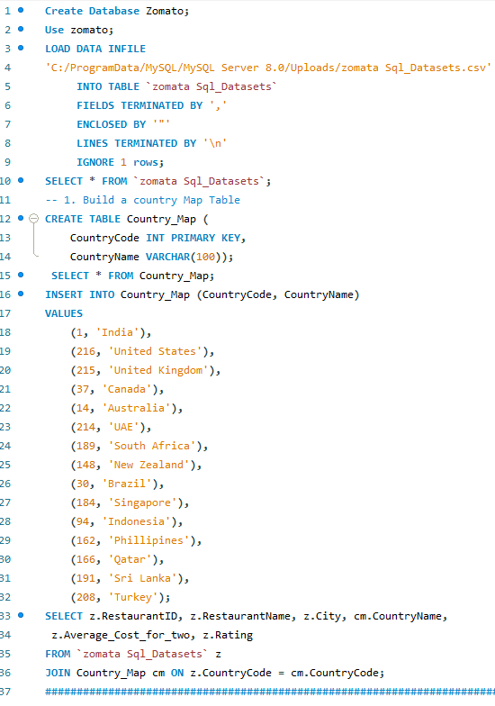
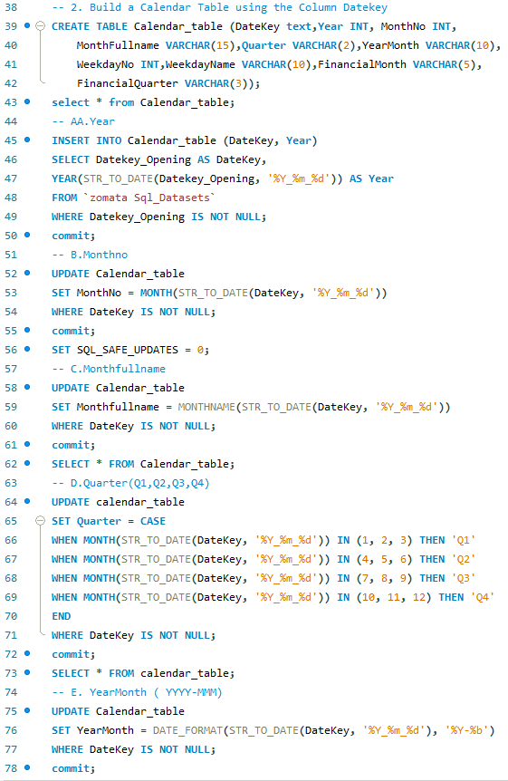
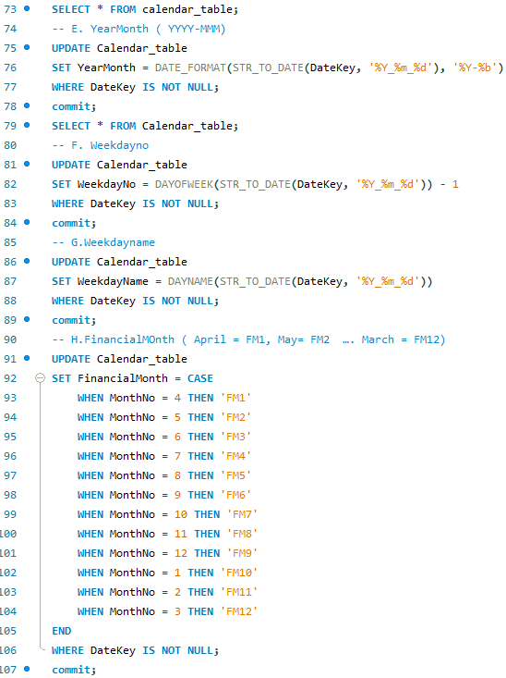
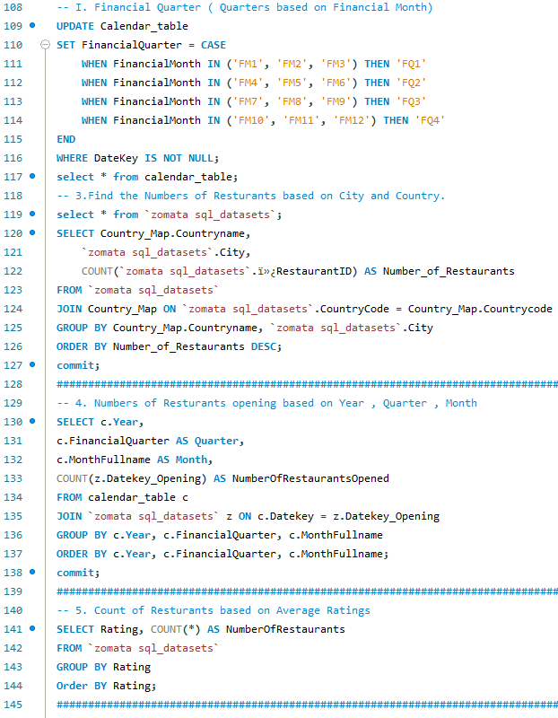
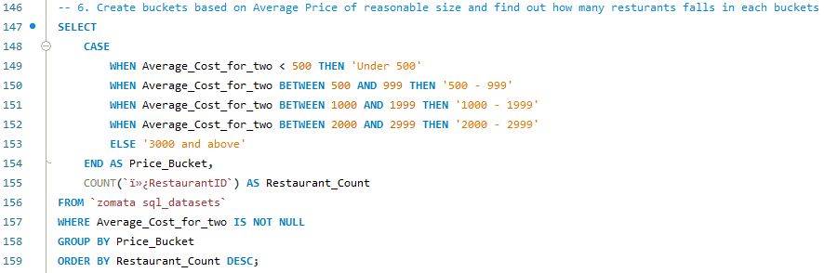
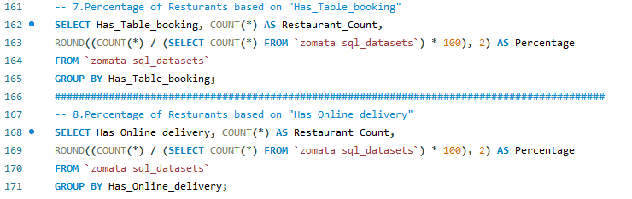
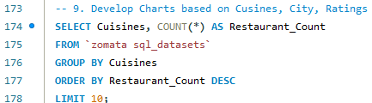
MySQL Queries
05

Slide 19
Conclusion
07
The restaurant industry is growing but faces challenges in:
Service Modernization: Introducing table booking systems and enhancing delivery capabilities.
Quality Improvement: Encouraging better customer experiences.
Market Expansion: Bridging gaps in premium offerings and untapped regions.
By addressing these areas, Zomato can solidify its role as a leader in modernizing the food ecosystem and capturing long-term growth opportunities.

Slide 20
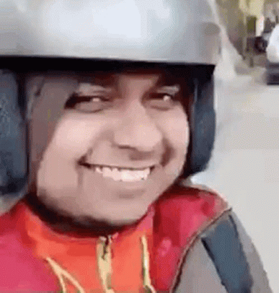
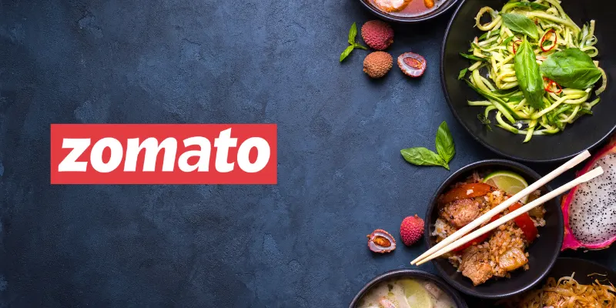
Thank you!

